Slide 1

T0-DO LIST Tracker
To-Do List
Tracker
Presented By:
Gundagani Nanda Kishore
&
Ankit Sharma
Developed By
Nanda Kishore

Slide 2

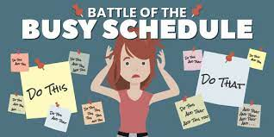

Slide 3

Presenting Our Application:
TO-DO LIST Tracker

Slide 4
About Our Application:
One of the Best Application to manage all your tasks.
You can Add and schedule your tasks easily.
You can Update, delete the existing tasks.
Get Reminded about the incompleted tasks.
Categorize your tasks based on the priority.
Delete Your tasks after completion.

Slide 5
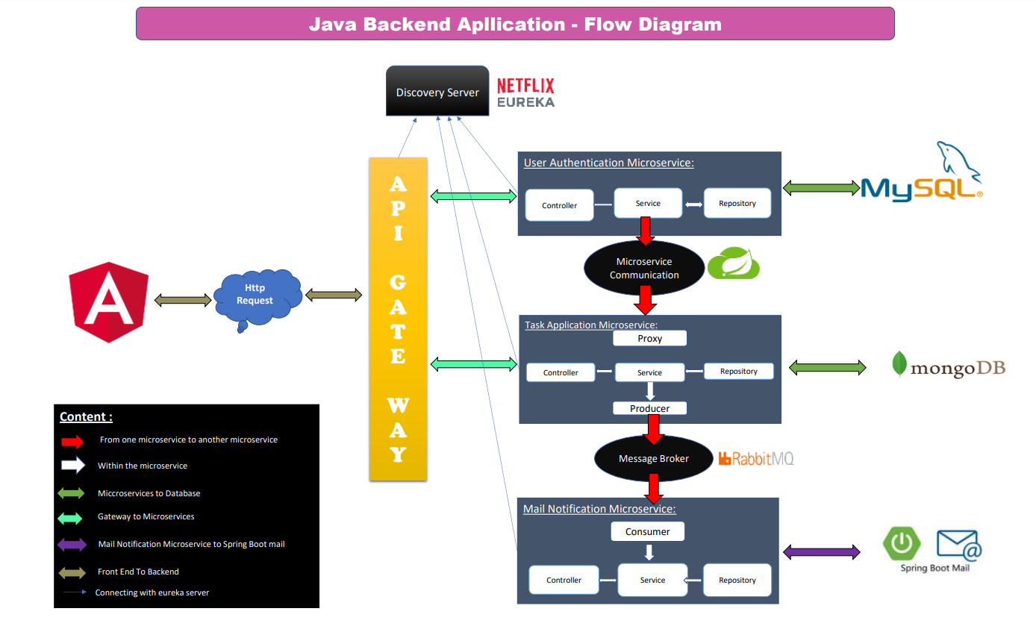

Slide 6
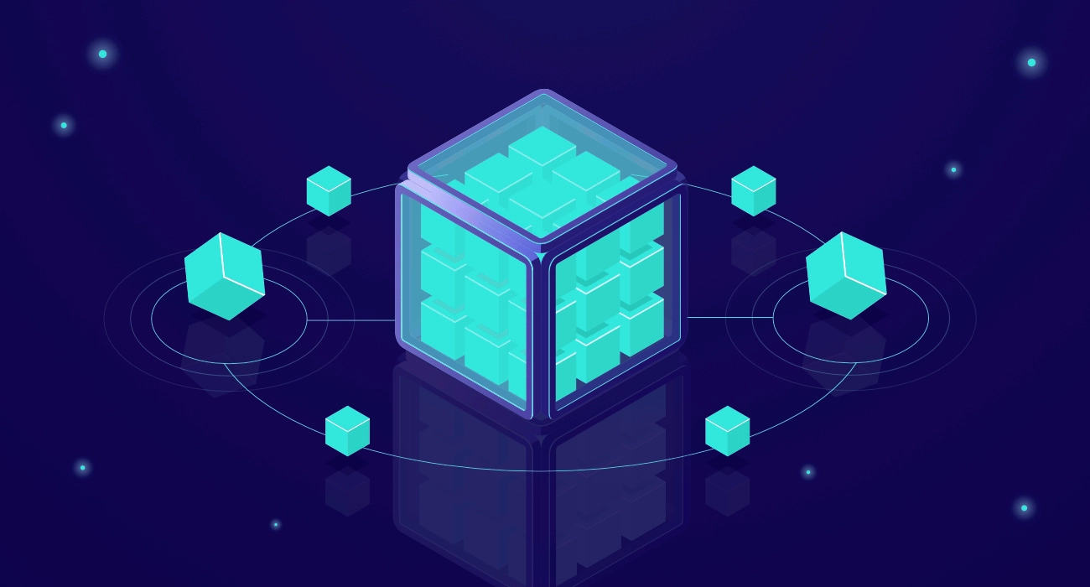
Microservices
Microservices are an architectural and organizational approach to software development where software is composed of small independent services that communicate over well-defined APIs.

Slide 7
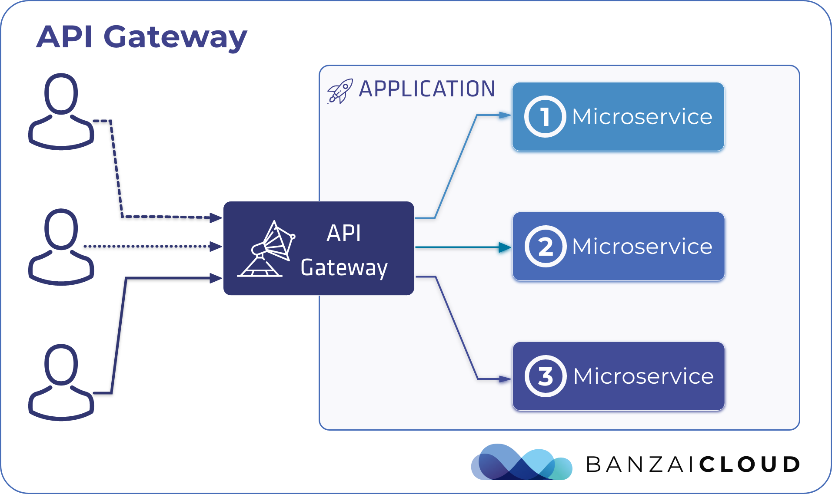
API Gateway :
Provides a Single Endpoint or URL for the client apps and then internally maps the request to a group of internal microservices.

Slide 8
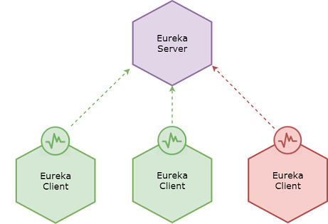
Eureka Service :
Every Micro service will register into the Eureka server. It knows all the client applications running on each port and IP address.

Slide 9
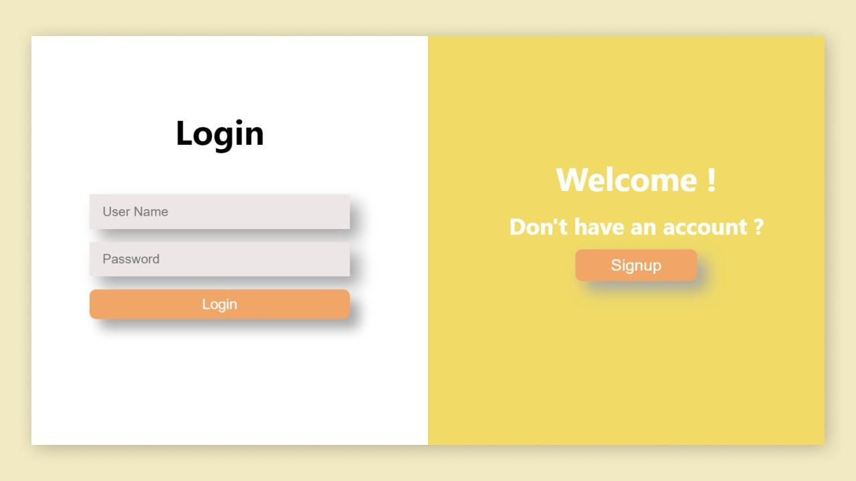
Authentication Service :
Registering and Authentication will takes place here and if authentication is success, we can perform task operations.

Slide 10
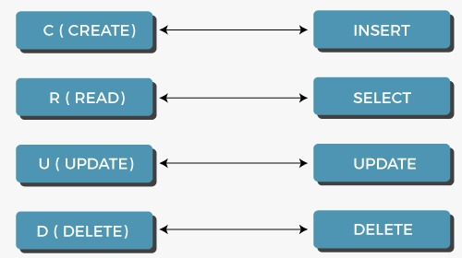
Task Service :
All the task Task Operations will takes place in this service.

Slide 11

Mail Notification Service :
Sends Notification to the Users Email when they register successfully.
If the user forgot password they’ll get the password to the registered Email.

Slide 12
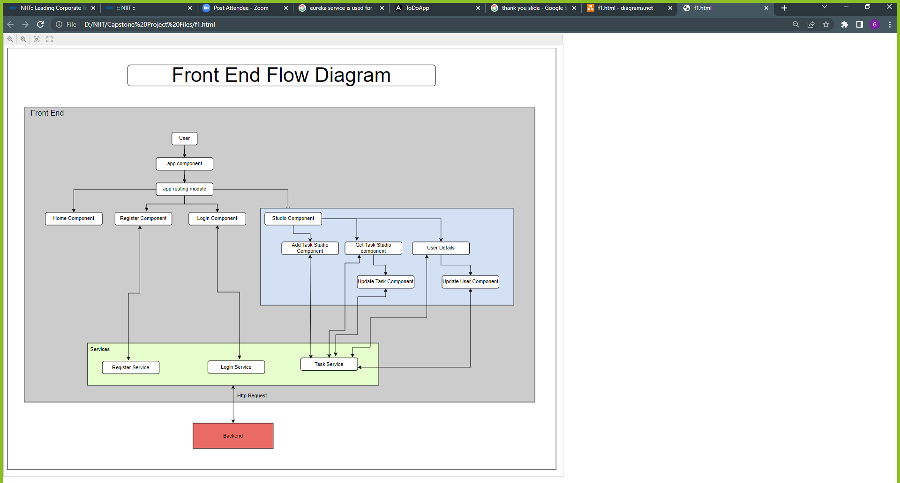


Slide 13

Tools and Technologies

Slide 14




Front End
1. HTML
2. Cascading Style Sheets (CSS)
3. BOOTSTRAP
4. ANGULAR

Slide 15

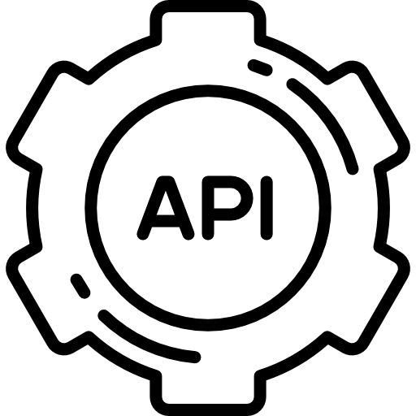




Back End
1. Java
2. Feign Client
3. Rabbit MQ
4. Spring Boot
5. API Gateway
6. Eureka Server

Slide 16


Data Bases
1. My SQL
2. Mongo DB

Slide 17


